Slide 1
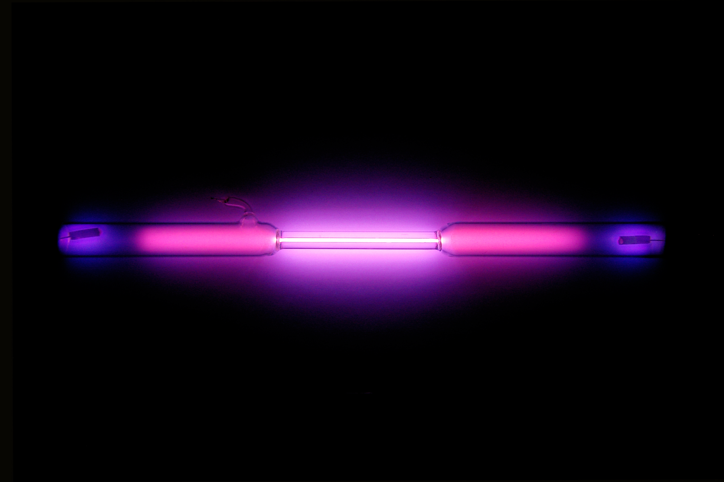
Phase Transitions of Argon
Argon Wikipedia

Slide 2
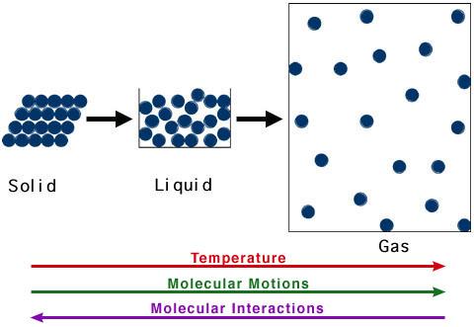
Core Concept
Simulate phase transition of substance with gromacs
Observe changes in potential energy
R. Casiday and R. Frey, Washington University

Slide 3
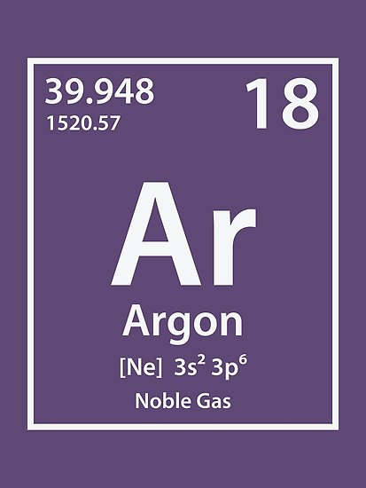
Argon
Noble gas → inert
Does not react
Monoatomic as liquid and gas
Simple Force-Field

Slide 4
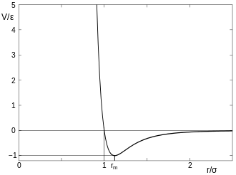
Force-Field
Pauli-Repulsion
Prevents overlapping
London-Dispersion
Induced dipol-dipol interaction
→ Lennard-Jones Potential
Lennard-Jones Potential

Slide 5
Force-Field
Pauli-Repulsion
Prevents overlapping
London-Dispersion
Induced dipol-dipol interaction
→ Lennard-Jones Potential
Lennard-Jones Potential

